Slide 1

Budget in Brief
FY 2021-2022

Slide 2
The purpose of the budget is to plan necessary operating and capital expenditures for the next fiscal year (Oct. 1, 2021 – Sept. 30, 2022).
The budget supports a multitude of services that are delivered by 14 departments. The total expenditure amount to provide these services is $38,631,606.
The budget is guided by:
• City Council’s Vision, Strategic Goals, and Community Values
• The City’s Principles of Sound Financial Management
• City Budget Policies
BUDGET OVERVIEW

Slide 3
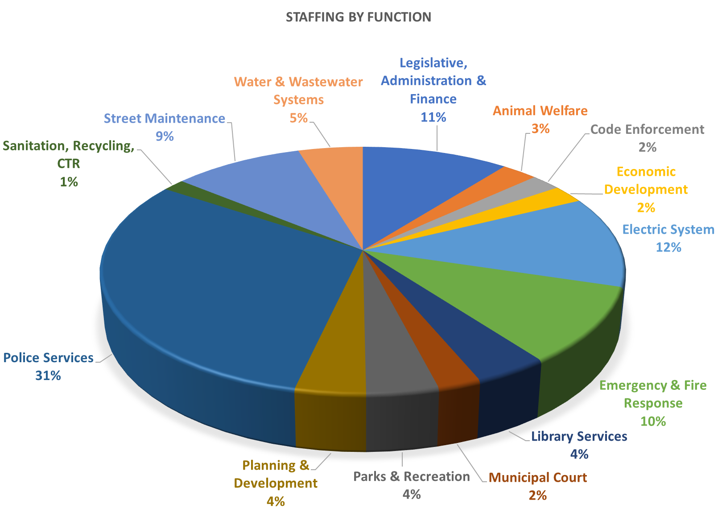
List of City Services
No. of employees
Administration & Finance 11
Police Services 36
Animal Welfare 7
Code Enforcement 2
Planning & Development 4
Fire/Rescue and EMS 14
Municipal Court 4
Library Services 9
Parks & Recreation 8
Street/Drainage Maintenance 16
Electric System 15
Water & Wastewater Systems 9
Sanitation & Recycling 3
Economic Development 2

Slide 4
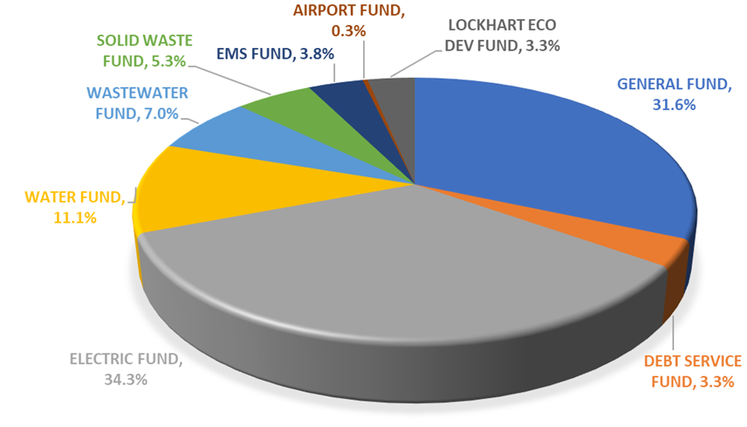
Total Annual Operating Revenues - $38,202,267.00

Slide 5
GENERAL FUND REVENUE SOURCES
(2021-22 - $12,550,366)
Where does the money come from?

Slide 6

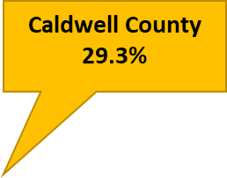

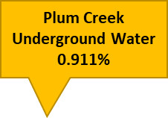

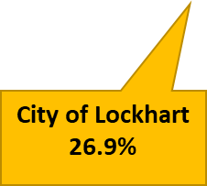
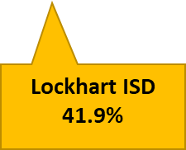
26.9% of a property tax bill is designated for the City of Lockhart

Slide 7
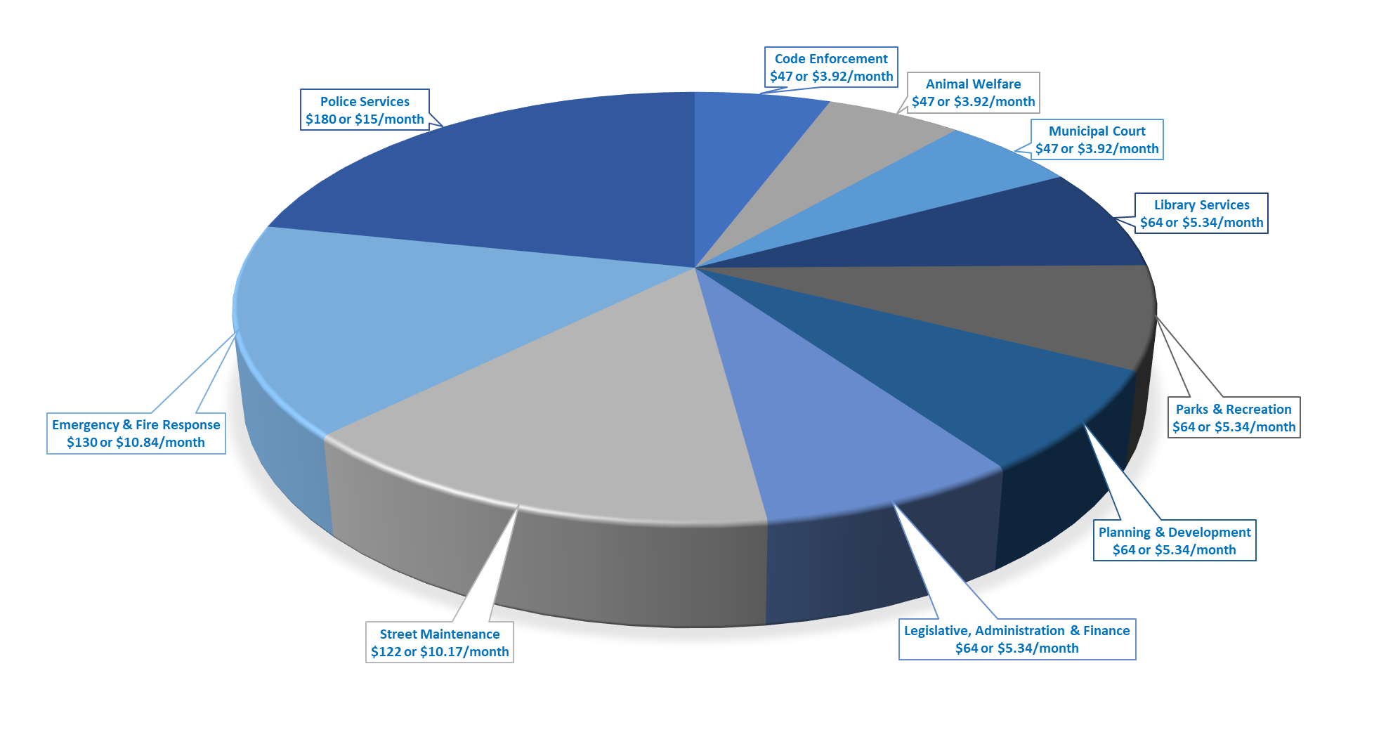
How much a $150,000 home pays for in General Fund services annually from property tax?

Slide 8
Where do your Sales Taxes go….

Slide 9
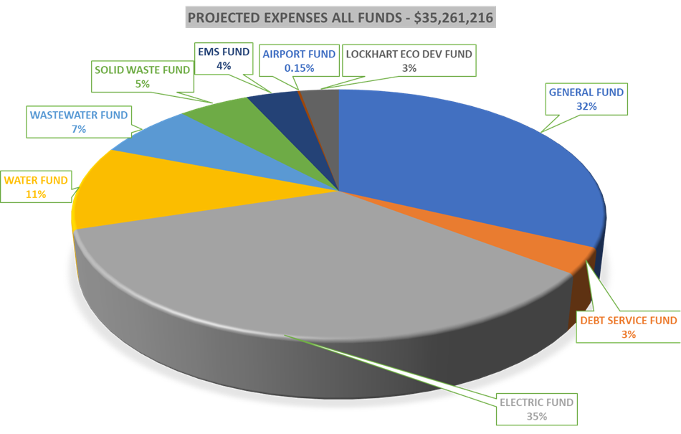
Where does the money GO?
Total Annual Operating Expenses - $38,631,606.00

Slide 10
GENERAL FUND EXPENSES
(2021-22 - $12,542,528)

Slide 13
2021-22 Adopted Strategic Goals
Goal #1 – COVID-19 Management along with Caldwell County hub/vaccine distribution
Goal #2 – Community Clean-up and appearance
Goal #3 – Customer Service
Goal #4 – Downtown Improvements including public facilities
Goal #5 – Comprehensive set of capital improvements & financing
Goal #6 – Park Improvements & grant applications
Goal #7 – Workforce Diversity
Goal #8 – Traffic Signal/safety improvements at South 183 @ Southside
Goal #9 – 2040 Comprehensive Plan
Goal #10 – Creation of summer recreation program with LISD

Slide 14
Top 10 Major Employers
Top 10 Taxpayers
Taxable Value
Walmart Stores Texas $9,027,430
Economy Realty LTD 7,637,710
(Serta – real property)
LCRA Transmission Group 5,526,490
Lockhart DMA Housing 5,100,000
(Sunchase Square Apartments)
HEB Grocery 4,984,010
WalMart Properties Inc. 4,474,210
Lockhart Village Partners 4,004,560
(Southpark Village Apartments)
Dormae Products, Inc. 3,537,020
(Serta – personal property)
Stanton XT VRH Holdings 3,137,480
Bluebonnet Electric Coop $3,032,560
Lockhart ISD 731
Walmart 225
Serta/Dormae Products 180
MTC (Lockhart Correctional) 175
H E Butt Grocery 170
Pegasus Schools 149
City of Lockhart 145
Student Transportation 85
Parkview Nursing 80
Chisolm Trail Nursing 76
General Obligation Bond Rating - AA- Standard
& Poor’s

Slide 15
LOCKHART AT-A-GLANCE
Population | 13,924 (2018)
Geographic size | 15.6 sq. miles
Median age | 38.2
Labor force | 5,948
Average annual wage for jobs in location | $39,637
Median Household income for residents | $53,570
Educational attainment age 25+ | HS graduate: 42.1% Associates: 4% Bachelors: 9.6% Graduate Degree: 4%
Sources: U.S. Census Bureau, Population Division; U.S. Census Bureau, American Community Survey; CHMURA Economics & Analytics, JobsEQ

Slide 16

REPRESENTING
LOCKHART
CONTACT US
CITY COUNCIL
Lew White, Mayor
Angie Gonzales-Sanchez, Mayor Pro-Tem
Juan Mendoza, District 1 Council Member
David Bryant, District 2 Council Member
Kara McGregor, District 3 Council Member
Jeffry Michelson, District 4 Council Member
Brad Westmoreland, Council Member At-Large
308 W. San Antonio St.
Lockhart, Texas 78644
Website: www.lockhart-tx.org
Phone: 512-398-3461

